Slide 1
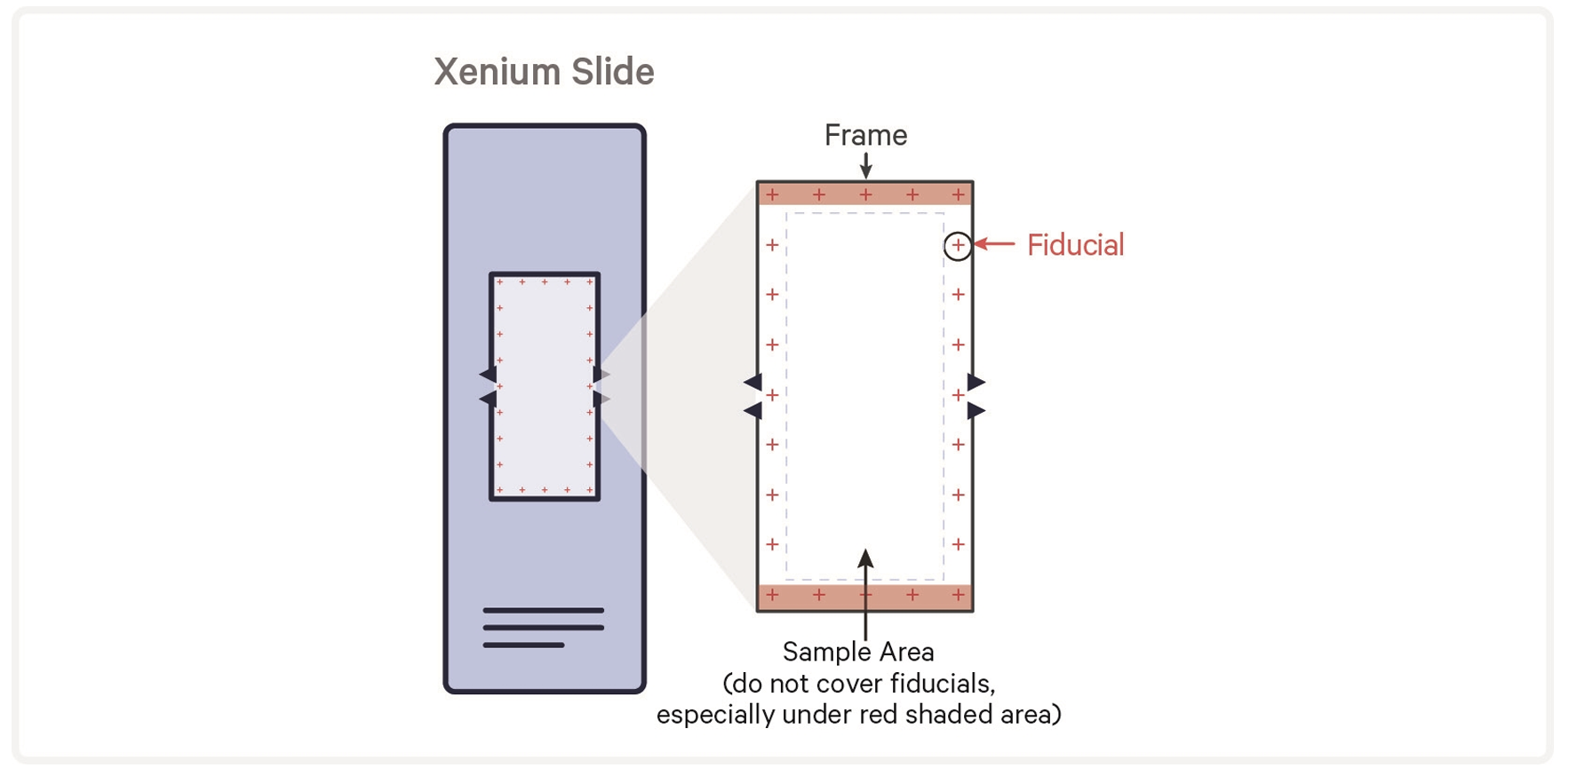
10.45mm
22.45mm

Slide 2
GeoMx LN FFPE Blocks (Groups A-F)
>11.25mm
>5.5mm
If needed, separate lymph nodes to save space
>11.25mm

Slide 3
Xenium Slide 1
Xenium Slide 2
Group A
Group C
Group D
Group E
10.45 mm
Group F
Group B
Group G (Naïve LNs)
MC3 D7
MC3 D14
LNP7 D7
LNP7 D14
22.45 mm

Slide 4
Ova-GeoMx exchange experiment
Group A- Ova-GeoMx01 6wk
Group B- Ova-GeoMx02 6wk
Group C- Ova-GeoMx01 6wk + Ova-GeoMx02 3wk
Group D- Ova-GeoMx02 6wk + Ova-GeoMx01 3wk
Group E- Ova-GeoMx01 3wk
Group F- Ova-GeoMx02 3wk
Group G- Naïve LNs

